Slide 1
Introduction to mathematical modeling
Cristina Lanzas and Shi Chen
CBS 810 Infectious disease modeling

Slide 2
Learning objectives
List the different applications of mathematical models in infectious diseases
Explain the key steps of the modeling process
Describe the different types of models

Slide 3

What is a model?
A simplified version of some aspect of the reality
Notes:
If all aspects of reality, what is that? Capture 100% of reality.

Slide 4
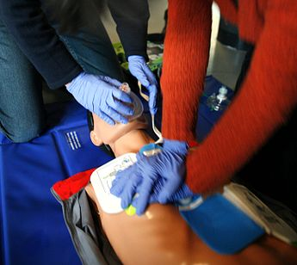
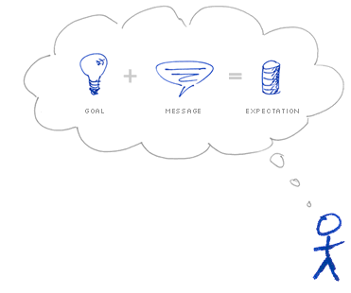
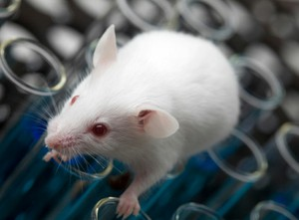
Model types
Mechanical
Animal
Mental
Mathematical
Graphical
Notes:
Mental-> philosophical; Mathematical model: use mathematics and other computational tools to investigate various processes and phenomena.
Must have some trade-offs in model (because it’s a simplification of reality).

Slide 5
Methods in infectious disease
Inoculation studies
Transmission experiments
Epidemiology
Molecular techniques
Mathematical models
…
Notes:
Diagnose, treatment, control, early warning… etc
Advantage of using math model: when experiment is infeasible (financially challenging; or simply inapplicable: what would happen if certain pathogen spread) Quantitative abstraction of reality

Slide 6
Mathematical vs Statistical Model
Statistical Model:
HOW does the data behave?
Usually incorporates response and independent variables
e.g. regression, ANOVA, time series analysis, etc.
Mathematical Model:
WHY does the data behave like this?
a.k.a. Mechanistic model
Notes:
An example: SI model. Statistical model: fit y~t (retrospective/predictive); mathematical model: more explicit; mechanistic model.

Slide 7
Infectious disease modeling
Epidemiology
Understand underlying mechanisms
Demographics
Identify areas of uncertainty and aid on experimental design
Evolution
MODEL
Contact structure
Understand and predict of temporal and spatial patterns
Immunology
Economics
Predict effect/cost-effectiveness of interventions

Slide 8
The scientific method
Formulate research question
Background information
Formulate hypothesis
Test with an experiment
Analyze results & draw conclusions
Results align with hypothesis
Results don’t align with hypothesis or only partially
Communicate results
Notes:
In vivo, in vitro
A hypothesis should be falsifiable.

Slide 9
The modeling process
Formulate research question
Background information
Formulate model
Model implementation and verification
Analyze results & draw conclusions
Results align with hypothesis
Results don’t align with hypothesis or only partially
Communicate results, prediction optimization, policy design
Notes:
In silico; Modeling and experiment are not independent; model rely on experiment to provide apriori information; experiment can be better adjusted or tuned by the models.
We use model to testify/falsify the hypothesis.

Slide 10
Modeling steps

Slide 11
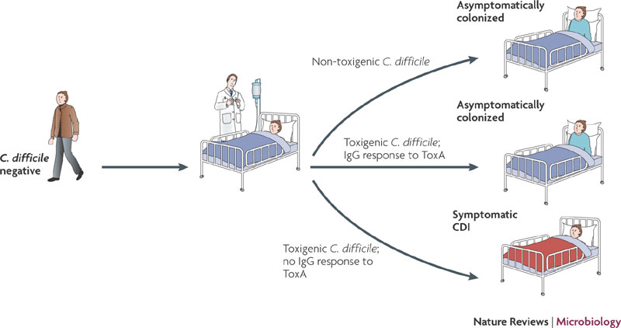
Clostridium difficile in health care settings
Notes:
For other nosocomial pathogens, such as MRSA, antimicrobial resistance causes treatment failure. For CD,

Slide 12
1. Formulate the research question
Most important step in modeling (and research) !
Provides criteria to decide what to ignore and what to include in the model
And of course a paper with a interesting research question is more likely to get published and to be read
Notes:
What has been done, what has not been done, and what remains under investigation, why it is important?

Slide 13
Asymptomatic carriers for Clostridium difficile
Transmission control measures are only applied to symptomatic patients
  Only patients with diarrhea are tested for C. difficile.
  Hand hygiene (soap and water)
  Contact precautions (gloves and gown)
  Environmental cleaning (hypochlorite)
Transmission from asymptomatic?
  Alcohol-based hygiene products are commonly used as primary form of hand hygiene in hospitals (C. difficile spores are resistant to alcohol)
Research question: Evaluate relative contributions of asymptomatic and symptomatic carriers to new infections

Slide 14
2. Gather background information
Epidemiology of the disease:
  Timelines of infection and disease, modes of transmission, epidemiologic patterns
Additional information: demographics, contact structure, behaviors, economics…
Available data ?
Notes:
Like a background check…

Slide 15
Infection and disease timeline data
Latent period: time from infection to transmissibility
Infectious period: duration (and intensity) of shedding infectious stages
Duration of the immunity? how effective, and for how long?
Population data
Population size, structure, and dynamics
Birth and death rates, survival, immigration and emigration
Rates of contact within and between population groups
Epidemiological data
Transmissibility (R₀)
- density dependence, seasonality
Notes:
Why do we need the data? (use a model to represent the data)
Occasionally we can formulate the model without data -> prediction. (use a statistical model: regression)

Slide 16
3. Formulate the model
Develop the conceptual model and decide model structure and type
  Elements to consider: Natural history of the infection, research question, available data, accuracy and time period over which model predictions are required
  Construct a flow diagram
  List variables and parameters.
Model formulation
  Choose mathematical framework for the model
  Write down the equations (variables, parameters,…)

Slide 17
Epidemiological states for C. difficile
Notes:
Based on four criteria: antimicrobial treatment, presence of C. difficile, presence of immune response against C. difficile and presence of C. difficile symptoms we defined the following epidemiological states for C. difficile in the model. Resistant individuals were defined as patients who had not received antimicrobial treatment and had a normal intestinal microbiota that provides “colonization resistance” against C. difficile. Susceptible patients received antimicrobial treatment and could be colonized by C. difficile. We considered three types of colonized patients, asymptomatically colonized without protection, with protection, and diseased. We considered two types of asymptomatically colonized patients based on the risk of developing CDI.

Slide 18
Epidemiological model for Clostridium difficile transmission
RESISTANT
Restoration of colonization resistance
Antibiotic treatment
SUSCEPTIBLE
Colonization without immune response
Colonization with immune response
Treatment success
ASYMPTOMATICALLY COLONIZED WITHOUT PROTECTION
ASYMPTOMATICALLY COLONIZED WITH PROTECTION
Disease
DISEASED
Notes:
The flows among the different epidemiological states are as follows, resistant patients can become susceptible through antibiotic treatment, susceptible patients can become resistant as the normal microflora recovers, termed as the restoration of colonization resistance. Susceptible patients can become colonized with protection or without protection, those without protection can become disease after incubation period. Diseased patients are treated with antibiotics, either vancomycin or metronidazole, if the treatment is successful, patients become susceptible again as those two antibiotics have also considerable effect on the microflora, some patients loop several times through the cycle of susceptible, asymptomatically colonized, diseased and back.

Slide 19
3. Formulate the model
Variables : Entities that change overtime.
In the compartmental models are:
Microparasites: S (number of susceptible), I (number of infectious individuals), R (number of recovered individuals)
Macroparasites: M (mean number of mature worms in the host population), L (infective larvae in the environment)…
Parameters: Quantities that influence the dynamics of the model, but remain fixed over time.

Slide 21
3. Formulate the model
Model classification
Whether we track changes at the population or individual level
  Population-level model vs individual (agent)-based models
Treatment of variability
  Deterministic vs Stochastic
Treatment of time and space
  Discrete- vs Continuous time models
  No space, implicit or explicit space

Slide 22
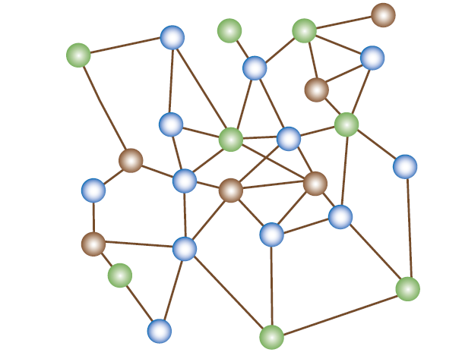
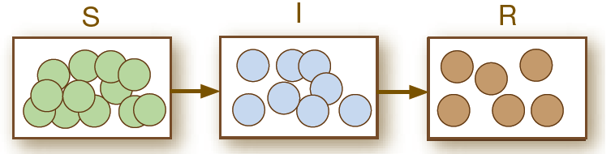
Compartmental vs Agent-based models
Compartmental model
Agent-based model
Population is subdivided into broad compartments, and the model tracks changes over time for individuals in the same compartment collectively.
Each individual unit is simulated.
Individuals are modeled as unique and autonomous entities.
Set of rules governs agents.

Slide 23
Deterministic vs stochastic model
In deterministic models, the future is entirely predicted by the model structure and initial values. It describes what happens on average in a population.
Stochastic models incorporate the effect of chance. They predict the probability of various outcomes.
Simulated number of infected animals with a deterministic model (red trajectory) and a stochastic model (blue trajectories).

Slide 24
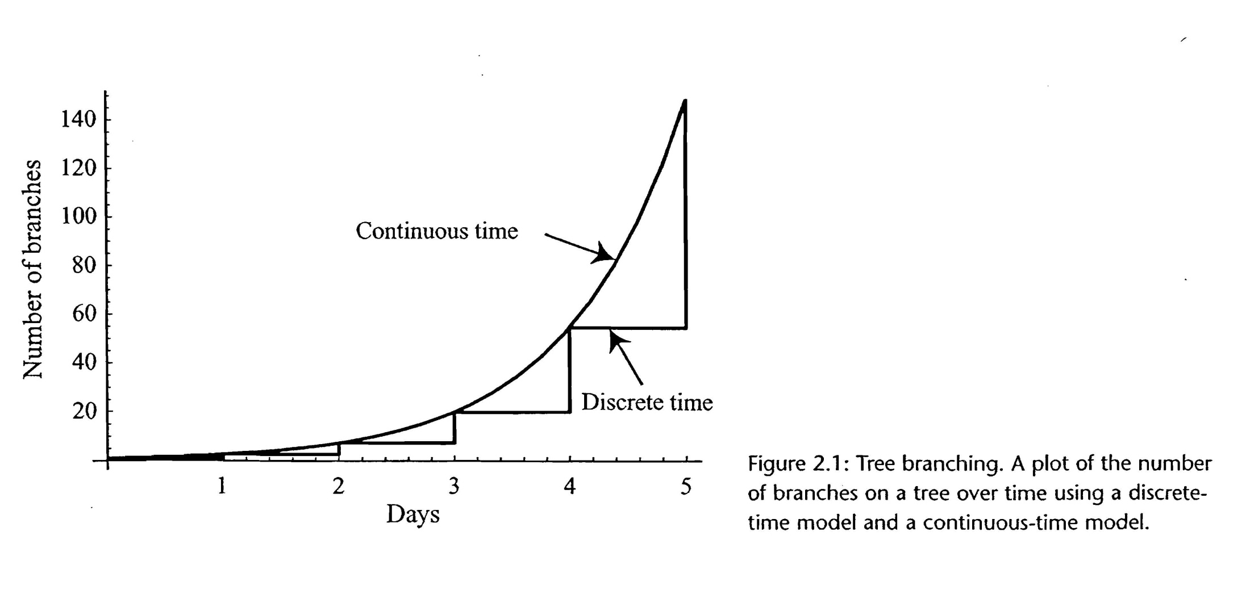
Continuous vs discrete time models
Decide whether you will treat time as discrete (tracks changes to variables in discrete time steps) or continuous (allows variables change at any point in time).

Slide 25
Continuous-time models
Real events occur in continuous
Discrete-time models
Data often recorded in discrete time intervals
Can match natural timescale of system, e.g. generation time or length of a season
Note: can yield unexpected behavior which may or may not be biologically relevant (e.g. chaos).
Time step effect on discrete time SEIR simulation

Slide 26
Examples of mathematical frameworks
Continuous time, deterministic dynamics
Ordinary and partial differential equations
Continuous time, stochastic dynamics
  Continuous time Markov chains
Discrete time, deterministic dynamics
  Difference equations
Discrete time, stochastic dynamics
Discrete time Markov chains

Slide 27


Slide 28
4. Model implementation and verification
Verification: Evaluate whether the model works as intended. The model is implemented properly and no errors are present on the code.
Validation: Assuring the appropriateness of the model to meet its objectives.

Slide 29
5. Model analysis
Graphical analyses
Simulations
Equilibrium and stability analyses
Derive general solutions
Determine the long-term or asymptomatic behavior
Analyze the model for periodic behavior

Slide 30
6. Relate the results back to the research question
Do the results align with the research hypothesis?
Can we generate testable predictions?
What additional data can be collected that would improve the model?
Do the results alter the way we think about the research question?

Slide 31
Empirical, experimental data
Model

